Slide 1
Overview
paul, mari, connor and darragh

Slide 2
What is a Computer?
The modern day definition of a computer is an electronic device capable of receiving and manipulating information or data, and processing it through programs to create new information or signals.
But in reality a computer is a device that can manipulate data to create information, so there are lots of computers we wouldn’t think of, such as a tally stick or a ruler or the brain
there are two main types of computer - macs and personal computers - macs being made by apple, pcs being made by microsoft.
now computers are mobile in the forms of laptops, and even mobile phones.
computers operate of a binary system, whereby they understand ones and zeros, nothing above. in computer terms there is no such thing as 2
Notes:
references go here:

Slide 3
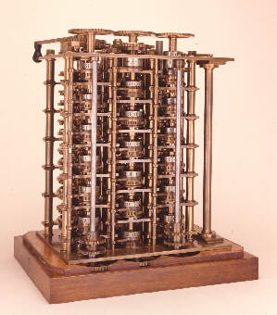
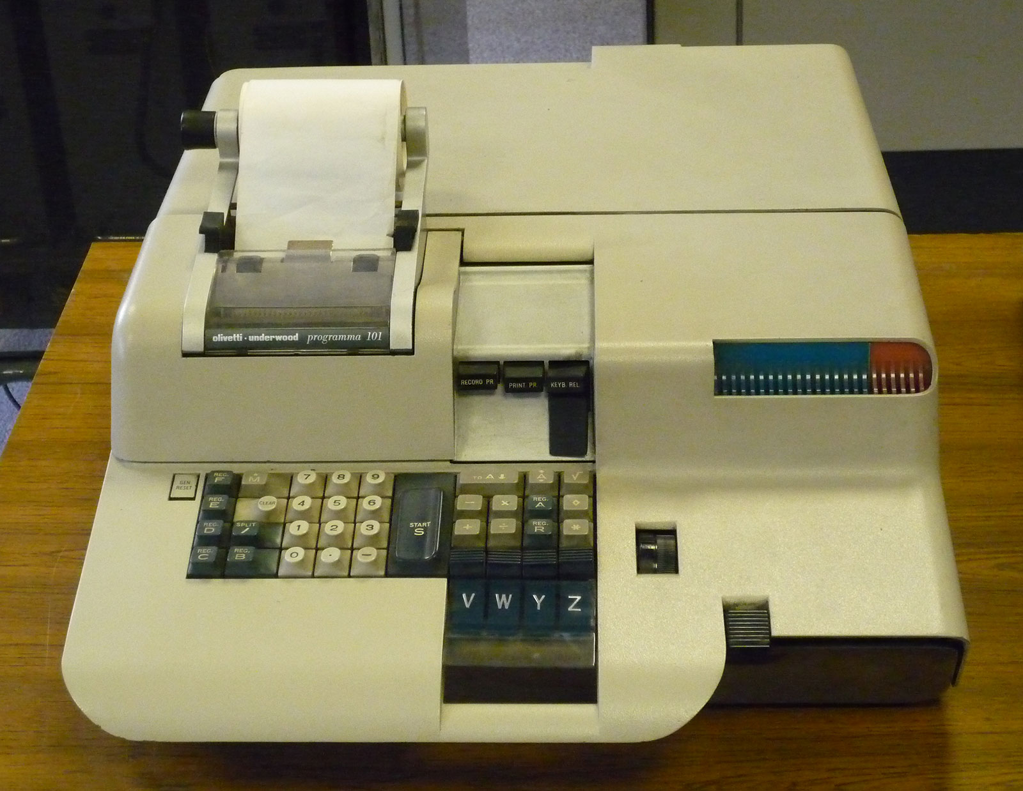
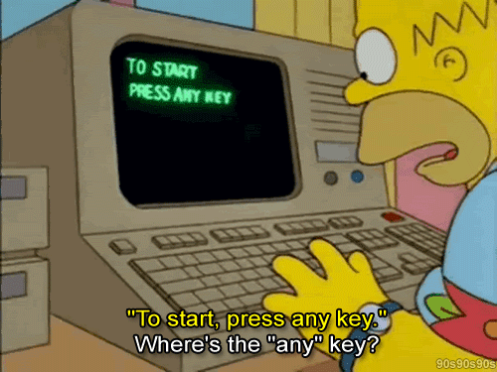
History of Computers
-Charles Babbage designed the analytical engine in the 17th century and although it was never completed, it is considered the first true “computer”.
-In 1941 Konrad Zuse invented the Z3 computer, which was the first working programmable, fully automatic computing machine.
-The Programma 101 was the world's first commercial computer.
Notes:
references go here:

Slide 4


What is a Computer Program?
A list of instructions that tell a computer what to do.
Usually carries out the instructions in the central processor.
System software and application software.
2 or more can be run at the same time - multitasking.
E.g., Mozilla Firefox, Safari & Microsoft Office.
Notes:
references go here: Wiki

Slide 5
History of Programming
Originally all computers were mechanically operated such as abacuses, but after the industrial revolution, computer programming accelerated rapidly.
In 1830, Charles Babbage began using punch cards to control his analytical machine. This could be said to be the first electronic programme.
in the 1880s, Herman Hollerith invented the recording of data that could be read on a machine.
The first high level computer programming language that was actually implemented was called FORTRAN. It was created in 1954. It was designed and developed by John Blackus who worked for IBM (previously TMC) and it stands for Formula Translation.
The most common types of programs for pcs are Windows 7, Windows 8 and WIndows XP, whereas with macs it are the iOS.
Notes:
references go here:

Slide 6

Who Developed C
C was developed by Dennis Ritchie in the early 1970s at Bell Laboratories for the UNIX operating system
C was derived from BCPL, a typeless computer language, and was an improvement on Ken Thompson’s B language which did not support data types or the use of structures.
Notes:
references go here:

Slide 7
Where is C used?
C was developed for UNIX but is useful for other operating systems, language compilers, text editors, data bases and language interpreters
C is a portable (can be easily transferred from one computer environment to another), stable and efficient coding language
Things developed with C and C++:
Adobe systems
Microsoft software
Most operating systems (Apple Mac OS X and Windows 8 etc.)
Google Chrome and Mozilla Firefox
Youtube
Games including StarCraft and World of Warcraft
Notes:
references go here:

